Slide 1
Springfield Area Working Communities Challenge
Amanda Sidler
WCC Coordinator, SRDC

Slide 2
The Working Communities Challenge in Vermont
Springfield Region received the grant in 2021
Provided by the Federal Reserve Bank of Boston
Notes:
The WCC is a 3 yr grant provided by the FRBB
The Springfield Region received the grant in 2021
As you can see from this map there are now 8 team in the state of VT covering 62% of the geographic area and half of the population

Slide 3
Mission of the Springfield Area Team:
To increase workforce participation by addressing the systemic barriers that prevent low- and moderate-income individuals from finding and maintaining employment.
Notes:
Unique grant opportunity for the communities to identify their own workforce related challenges and build strategies and experiment with potential solutions

Slide 4
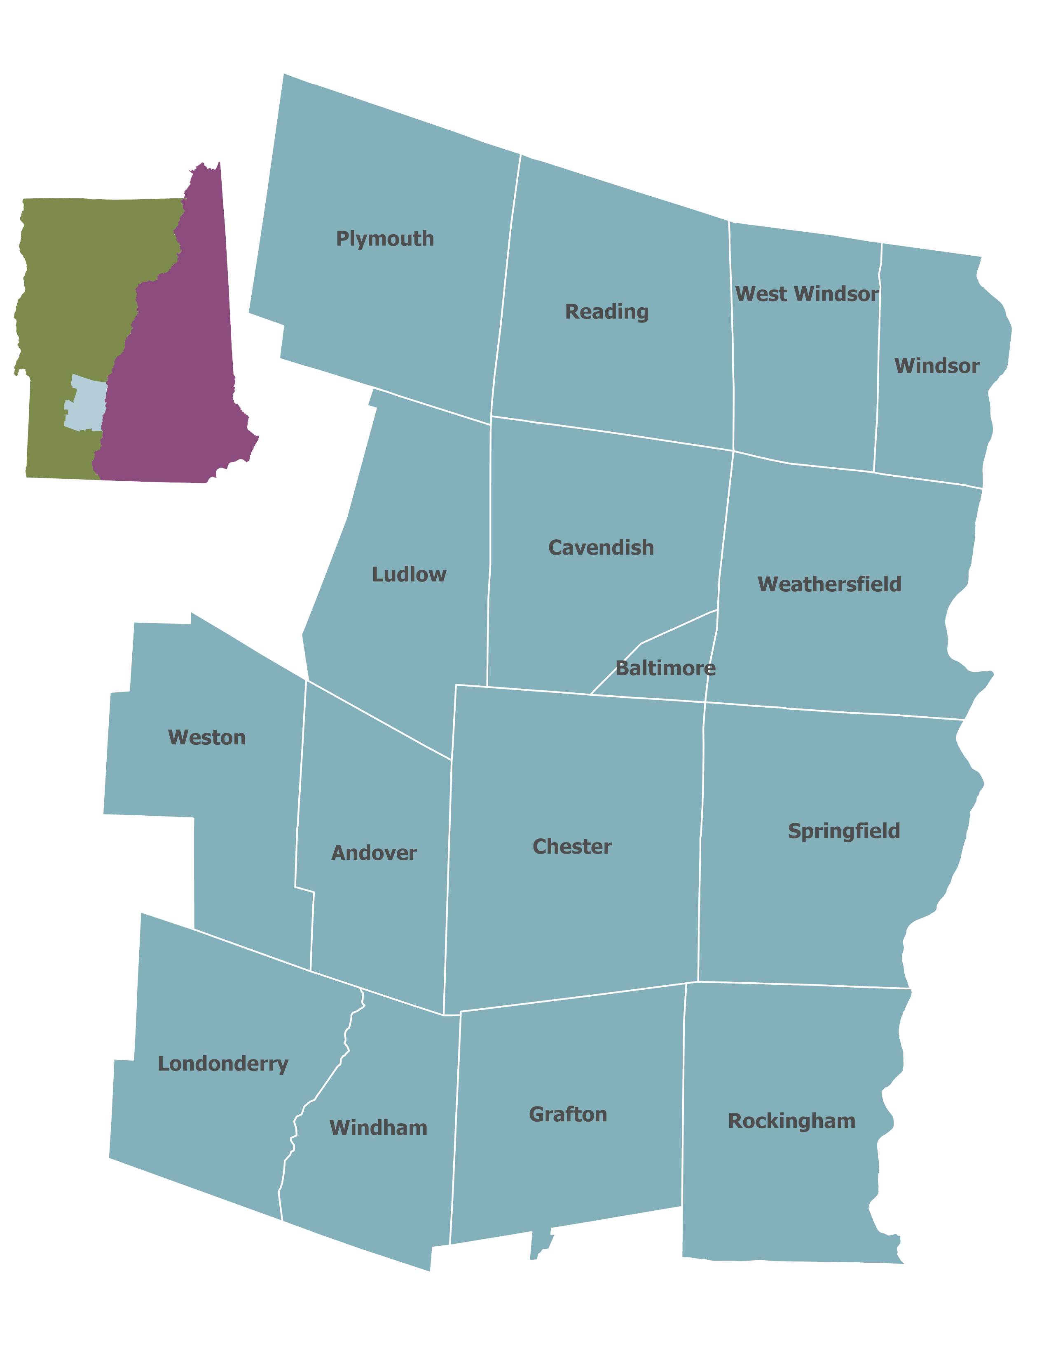
What is the “Springfield Region”
Springfield Human Services District
16 towns
Notes:
Want to clarify what the “Springfield Region” is
16 towns across the Springfield Human Services District

Slide 5
Identified Barriers to Employment
Transportation
Childcare
Housing
Technology/ Education
Recovery/Substance Use Disorder
Notes:
- Prior to the Springfield Region receiving this grant, members of the current core team worked together to identify what were the top barriers that were impacts sustainable employment

Slide 6
Coordinated Collaboration
Backbone:
SRDC
Service Providers
Employers
Community Organizations
Vermont Adult Learning
VT Agency of Human Services
Mount Ascutney Hospital & Health Center
River Valley Technical Center
Springfield Area Parent Child Center
Vermont Packinghouse, LLC
Mt. Ascutney Regional Commission
Reach Up, VT Agency of Human Services
Southeast Vermont Transit
Edgar May Health & Recreation Center
VABIR/HireAbility
Springfield Chamber of Commerce
Dept. of Labor
VSAC
Greater Falls Connections
Building Bright Futures
SEVCA
Notes:
One of the unique qualities of the WCC grant is that it’s designed to be a cross-sector collaborative process
As you can see we have a number of organizations participating in this work
This is not a complete list, roughly 30 involved at this point
SRDC functions as the backbone organization
several serve the specific role as members of the Core Team that functions as a sort of steering committee for the grant
Subcommittee participation - We’ve formed 2 subcommittees examining Transportation & Childcare

Slide 7
Springfield Team Strategy
Social Service Providers
Community Members
Employers
Coordinated Cross-sector Collaboration among Partners
“No wrong door” Holistic Support & Referral System
Notes:
As we think about this collaborative work – there are a number of strategies and initiatives that our team is working on
The primary goal of this work is to create a holistic workforce system
We call this our “No wrong door approach” – if an individual encounters a problem, they can go to a trusted person (either at work or a service provider) and that person will either know how to help solve that problem, or know where to go to find the answer
The work of addressing many of these challenges is often done in silos, and employers are frequently left out of the conversation, so we want to make sure that communication and resource sharing become a long-term solution to addressing many of these issues

Slide 8
Initiatives & Resources of the WCC
Childcare Counts Coalition
Employer Resource Group
Free Laptop Program
Employment Research Study
Notes:
We have a number of programs and initiatives that relate to the identified barriers
I don’t have time to discuss all of them – but I wanted to provide an idea of what our team has been working on

Slide 9
Employer Resource Group
Monthly Workshops with Content Experts
FREE, Open to all Employers
Topics:
Improving Job Listings to get Results
Utilizing Social Media for Recruitment
The Impact of Childcare on Employment
Notes:
One of our first initiatives during peak pandemic
Goal: Provide employers with actionable strategies for addressing barrier in their organizations –
Want to provide useful tools to address challenges pertaining to retention and recruiting
Our next meeting will be November 16th – topic will be on Planning Compensation for the Unknown Future of 2023 and strategic benefits

Slide 10
Employment Research Study
Topics covered by the survey
Employment Status
Seeking Employment
Benefit Utilization
Barriers to employment: Childcare, Transportation, Education
Quality of life
Notes:
How do you retain and attract people – understand who is coming through the door, what are their unique needs
This research study has allowed us to measure quantitative data
One of the challenges with living in a rural state is a lack of consistent data
We were approached by an individual who is a data analyst who is from the area and helped us build our own research study
Residents and employers registered to participate, and we release surveys every 2 months to gather long-term employment related data. We’ve now enlisted another consultant through the Federal Reserve to help us start reviewing the data
There are lots of questions and data points, so I just wanted to highlight a few things

Slide 11
Patterns of Employment
Available jobs do not match skillset
Insufficient Pay
Cannot find desired schedule
The biggest barriers:
Notes:
The first question we ask residents – Has your employment status changed? – consistently 10% respond yes
Are you seeking Employment? – fluctuates around 20-30% - Noticed that decreased over the summer, but seeing a steady increase again going into the fall with Sept at 25%
What are the barriers, and what is driving these trends?
Scheduling, Insufficient Pay, and Skillset – top 3 responses when asked what’s impacting their ability to find employment

Slide 12
Barriers To Employment
Notes:
Transportation is on the rise
Many situations where family relies on one working vehicle, or cost of maintenance is too high
Heard from partners at Reach Up that other costs – fines and tickets – people can’t afford to pay them down, so they lose their license and then they can’t earn an income
Childcare – 3 biggest issues – Schedule, Cost, Quality
For those that are unemployed, 25% of that group sites lacking childcare, as well as scheduling as their biggest barriers to securing employment
When we look at cost – the US DCF recommends families spend no more than 7% of their annual income on childcare – LGK has estimated that in VT families are spending as high as 30% - while in our region we’ve determined that it is roughly 18%

Slide 13
WCC Childcare Assistance Fund
Goal: To help parents and guardians stay engaged or re-enter the workforce.
Notes:
Last time I was here we had this grant program through our partners at the SAPCC
Provided financial support to 26 families totaling $20k - by Spring 2022 less interest in fund so we decided to transition away from it and focus on other areas of concern

Slide 14
Childcare Counts Coalition
Strengthening Communication & Information Sharing
Supporting ECE Workforce
Collating Resources for Childcare Providers
Primary Challenges for Childcare
Cost
Limited availability
Scheduling
Notes:
Primary challenges pertain to cost, availability of slots, and scheduling – but this system is broken for everyone in it
Our Childcare Counts group is working to better understand how these challenges manifest, but also develop regionally specific solutions while being mindful of the developments happening on a state and national level
We want to help strengthen the ECE workforce, which will help open new slots for care - According to a study conducted by Let’s Grow Kids, in 2019 the Sprfd region had to increase our childcare workforce by 106%, that is 126 new ECE staff members prior to the pandemic
We want to support providers, especially those that provide home-based care by helping connect them to resources targeted for small businesses
Address the childcare specific challenges on many fronts

Slide 15
Accessing Employment: Free Laptop Program
Members of community seeking employment or advancing education
Receive a free, refurbished laptop by River Valley Tech Center
Referral from Community Partner Organization (education/ human service organizations)
Notes:
Get current app number: distributed 100 laptops – collecting stories to see where are they now
Partners at RVTC help collect devices and distribute them – students
Collaboration with SEVCA & VAL to bring digital literacy
FRBB has donated over 60 devices to this program

Slide 16
Thank you!
Follow us on Facebook or visit our webpage for more information

Slide 17
Public Benefit Utilization
Notes:
WCC statewide is trying to understand how the risk of losing benefits is also dictating employment trends – benefits cliff
We know that hose experiencing generational poverty prioritize employment differently than those who have experienced financial security
Risk of losing benefits may dictate job seeking behavior
Benefits utilization indicates that 3Squares and WIC, as well as Fuel Assistance and Housing Assistance are most frequently utilized
What are creative ways that employers can help offset costs for their staff to help prevent putting them in a position of hitting that cliff or help others become more able to engage in the workforce
Trying to provide support not only builds trust with staff, but it can be a competitive recruitment strategy
Employers in this region that are taking proactive approach to meeting needs by closely examining what their people need
Area that needs further exploration and I’d hope that some of the employers here with us today might be interested inworking with our team on that

Slide 18
WCC Employment Research Study
Goal:
How does it work?
Who can participate?
All Employers – businesses of all sizes and industries
Anyone living in the Region – regardless of employment status!
Complete a short survey every 2 months
Data gathered will be shared with employers
Residents receive $40 per survey completed.
Identify the barriers to employment
What are the challenges facing employers and community members?

Slide 19
Childcare as a Barrier to Employment
Primary Challenges for Childcare
Cost
Limited availability
Scheduling
The average family in the Springfield Region spends up to 18% of their annual income on childcare.
Notes:
Research consistently shows that the 3 primary challenges families face when accessing care pertain to the cost, limited availability (especially for infants), and schedules not aligning with work hours According to LGK’s in VT 3/5 infants cannot find slots in a regulated care environment – pushing families to use unregulated care or hire private professionals
Our own research study also reflects these barriers with cost and scheduling being the consistent top 2 barrier faced by individuals participating in the study

Slide 20
WCC Childcare Assistance Fund
Eligibility
How to apply
Live within the SAWCC Region
Physical custody of at least one child living in the home.
At least one parent/guardian in the household is working or seeking employment
There is no income requirement to access the fund
Contact Springfield Area Parent Child Center – ask for Working Communities Childcare Fund

Slide 21
Who is Involved?
Extended Partner Network
Core Team
Backbone Org (SRDC)

Slide 22
WCC Subcommittees
Understanding challenges – impact on individuals, families, partners and employers
Documenting existing resources
Working to create systemic change
Transportation Taskforce
MARC
Vermont Dept. of Trans.
The Moover
Reach Up
CHT members
Working Fields
HireAbility
Childcare Counts Coalition
SAPCC
Building Bright Futures
Let’s Grow Kids
Reach Up
HCRS
AHS
Edgar May
School Districts
Local Providers

Slide 23
Who is Involved?
CORE TEAM:
River Valley Technical Center
Reach Up, VT Agency of Human Services
Springfield Regional Development Corporation
Vermont Packinghouse, LLC
VT Agency of Human Services
COMMUNITY PARTNERS INCLUDE:
Mt. Ascutney Regional Commission
Springfield Area Parent Child Center
Edgar May Health & Recreation Center
Vermont Adult Learning
SEVCA
Southeast Vermont Transit/ The MOOver
Mount Ascutney Hospital & Health Center
VSAC
VTrans
Working Fields
VT Department of Labor
Many more…

Slide 24
Initiatives & Resources of the Springfield WCC
Network Building
Employer Resource Group
Accessing Employment
Free Laptop Program
Childcare
ECE Workforce

Slide 25
Windsor Microtransit Program
The Micro-Moove
Town of Windsor 1of 5 towns to receive a 3-year pilot program
Free, public Uber-like transportation service
Notes:
Our Transportation subcommittee, which is made up of reps from SEVT, Vtrans, MARC, and Mt. Ascutney Hospital, served as the steering committee for feasibility study
The concept is that the town of Windsor, which previously did not have a public transit system, would now have an uber like system – with a small van that can serve the community
Based on our Research Study, we’re seeing a consistent rise in transportation as a barrier to employment – Over the course of the year the most frequently recorded barrier pertained to only have one operational vehicle that multiple people or a family are reliant on – now seeing a transition to No longer having an operational vehicle as well as affordability being a factor – all of these have increased in frequency
This service, which will hopefully be road ready in early 2023 will be a hue step in the direction of trying to provide more creative transportation solutions – continue to try to develop creative solutions for around the region to support transportation as a critical part of accessing employment

